Slide 1
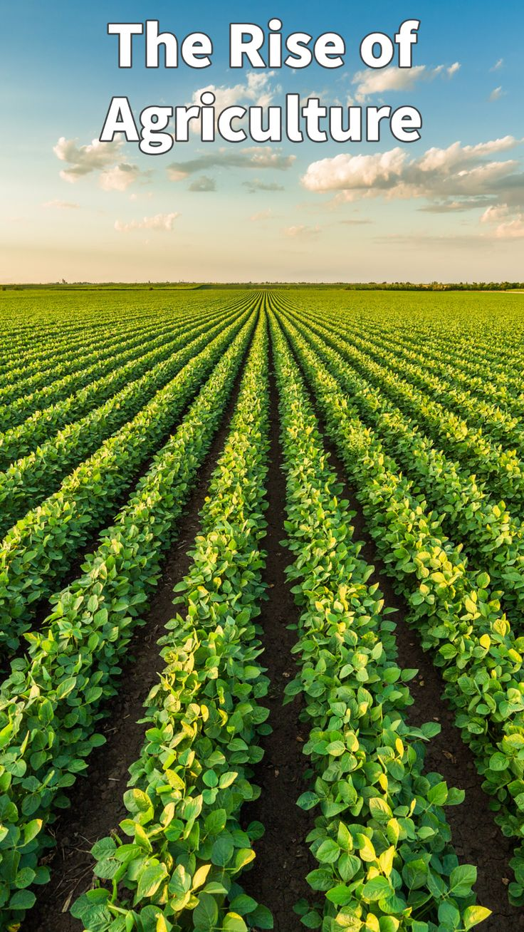
Food and Agriculture
Tech-enabled solutions for a more sustainable and food-secure future

Slide 2
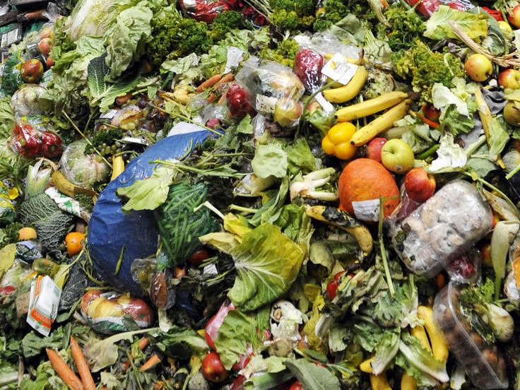
The Challenges Facing Food and Agriculture
Food security: 1 in 9 people lack access to sufficient food
Sustainability: agriculture is a significant contributor to greenhouse gas emissions and water pollution
Waste: 1/3 of all food produced is lost or wasted
Soil Erosion: The degradation of soil quality limits the land available for agriculture, affecting productivity.

Slide 3
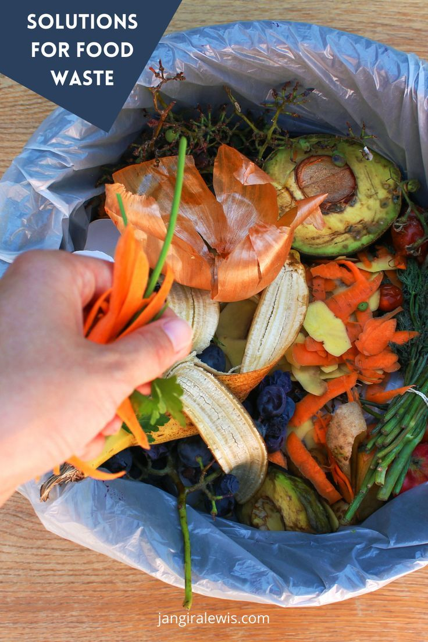
Tech-enabled Solutions for Food and Agriculture
Increasing yield through precision agriculture and vertical farming
Reducing waste through efficient supply chain management and innovative packaging
Improving food security through digital platforms and inclusive food systems
Ensuring sustainability through regenerative agriculture and renewable energy
Data Collection: IoT devices collect real-time data on soil conditions, weather, and crop health, enabling farmers to make informed decisions.
Remote Sensors: These sensors monitor soil moisture and nutrient levels, helping optimize water and fertilizer usage

Slide 4
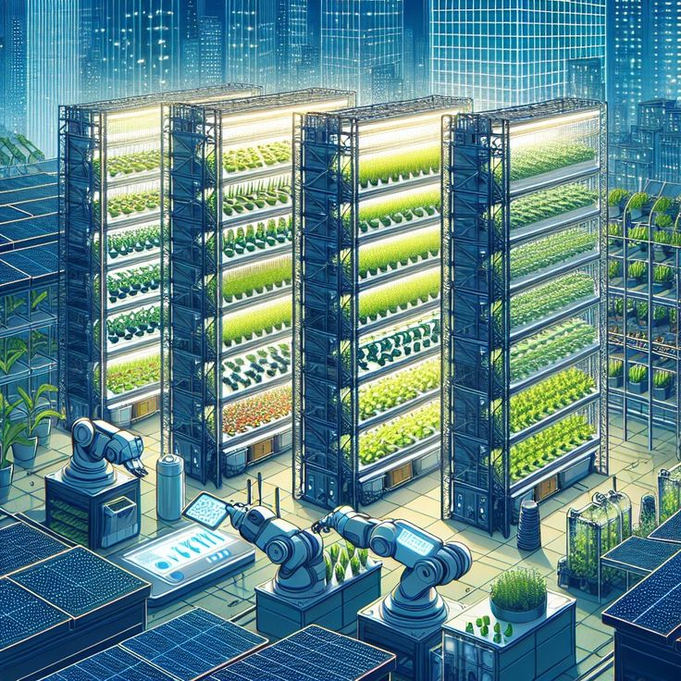
Precision Agriculture and Vertical Farming
Precision irrigation systems: optimizing water usage with Python-based sensor data analysis
Crop monitoring: using drones, satellite imaging, and IoT sensors to identify optimal crop varieties and planting schedules
Data analytics: identifying trends and patterns to improve crop yields
Reduced Transportation Costs: Producing food closer to consumers reduces the carbon footprint associated with transportation.
Water Conservation: Uses significantly less water than traditional farming due to recirculating systems
Both precision agriculture and vertical farming represent the future of food productionReduced Transportation Costs: Producing food closer to consumers reduces the carbon footprint associated with transportation.
Water Conservation: Uses significantly less water than traditional farming due to recirculating systems)

Slide 5
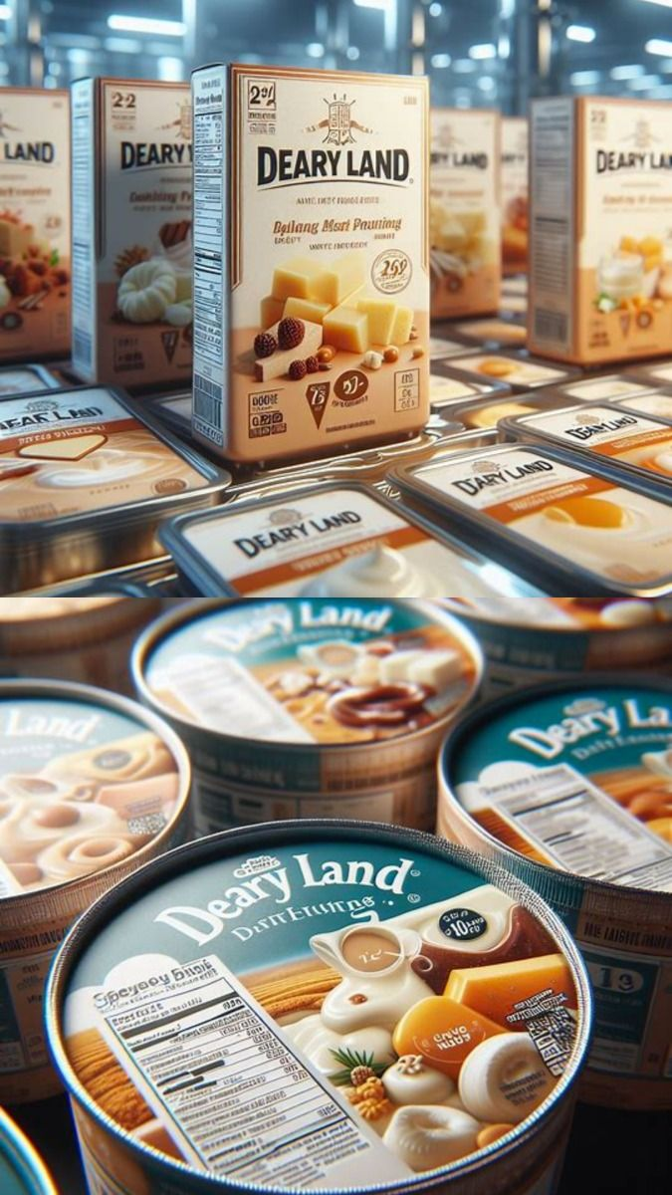
Efficient Supply Chain Management and Innovative Packaging
Implementing efficient supply chain management systems to reduce food waste during transportation and storage
Developing innovative packaging solutions to extend shelf life and reduce food spoilage
Creating food recovery systems to redistribute surplus food to those in need

Slide 6
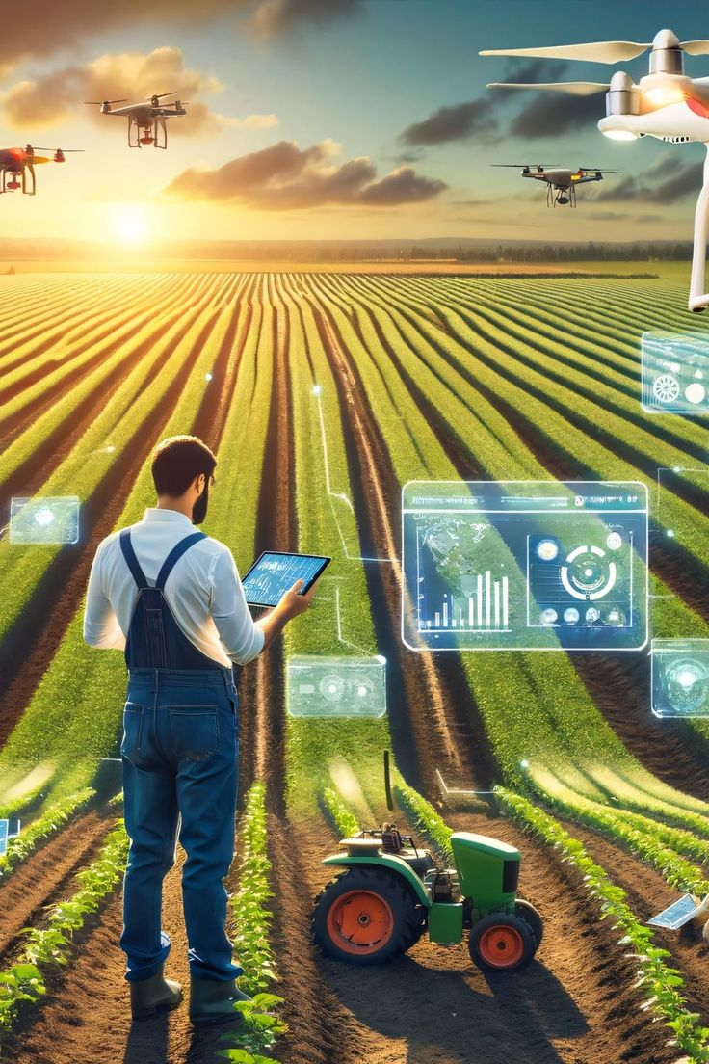
Digital Platforms and Inclusive Food Systems
Developing digital platforms to connect farmers with consumers, reducing intermediaries and increasing access to fresh produce
Implementing mobile-based solutions for farmers to access market information, weather updates, and best practices
Creating inclusive and equitable food systems that promote access to nutritious food for all

Slide 7
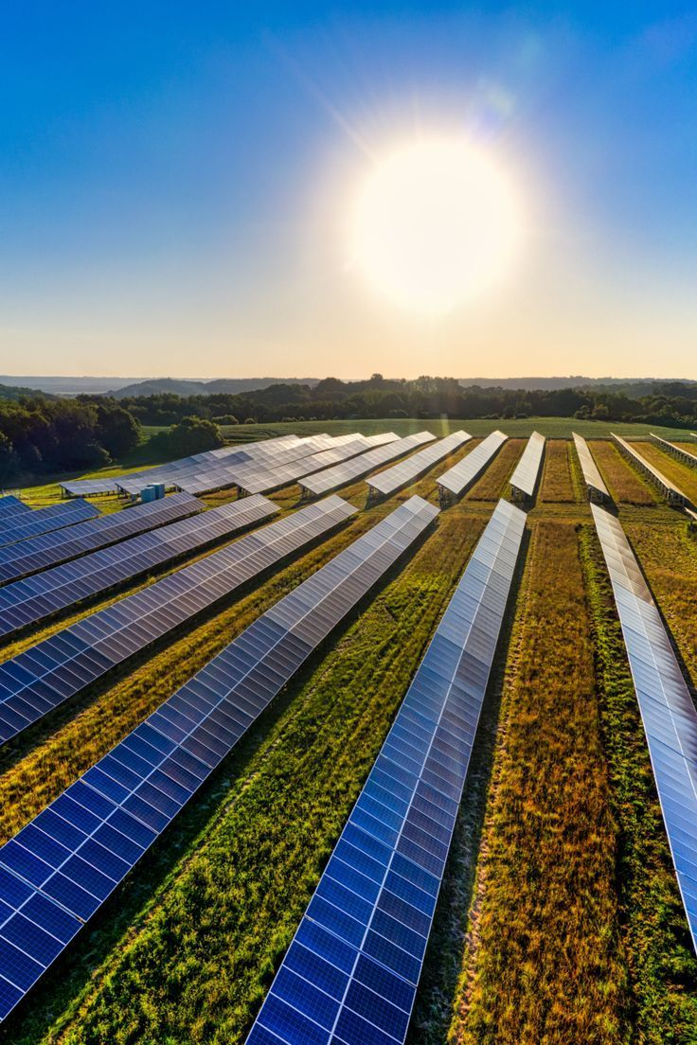
Regenerative Agriculture and Renewable Energy
Promoting regenerative agriculture practices that enhance soil health, biodiversity, and ecosystem services
Developing sustainable water management systems to reduce water usage and protect water resources
Implementing renewable energy solutions to power food production, processing, and distribution

Slide 8
Tech-enabled Solutions for a Sustainable and Food-secure Future
Call to action: "Join us in developing tech-enabled solutions for food and agriculture
Protect crops, boost field and make urban areas suitable for farming
Ensure food safety as it can monitor equipment conditions
Identifying areas of waste
Remote Sensors: These sensors monitor soil moisture and nutrient levels helping optimize water and fertilizer usage, this will therefore reducing waste
Data Collection: IoT devices collect real time data on soil conditions, weather and crop health, enabling farmers to make decisions

